Slide 1
A comparative study of the Multipath TCP for the Linux kernel
Korhan Demirkaya, Shubham Saini
CSE 222a Class Project
Instructor: Dr. Alex Snoeren

Slide 2
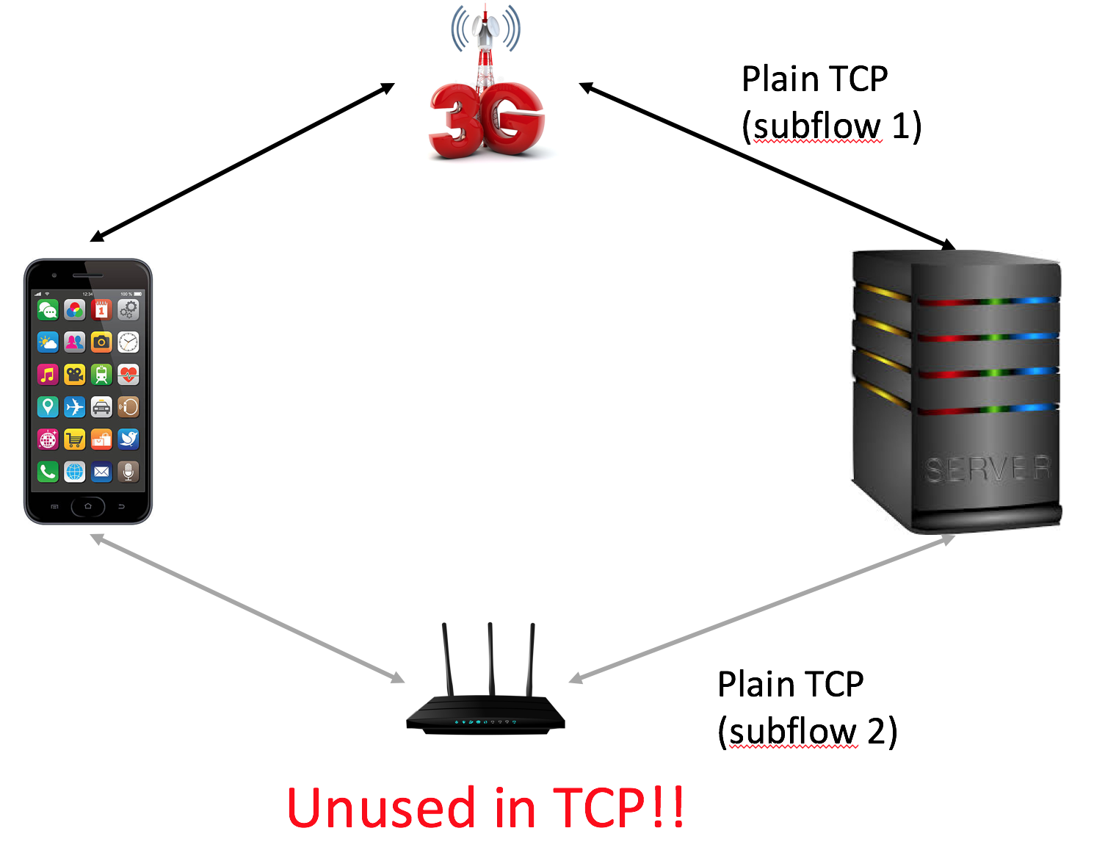
TCP vs MPTCP
TCP | MPTCP
Connection between two interfaces | Connection between two hosts
Single path, one interface for transmission. | Can use multiple interfaces and links including Wi-Fi and mobile networks. Backward compatible
No link handover capability | Link handover at the end points through abstraction in the transport layer.

Slide 3
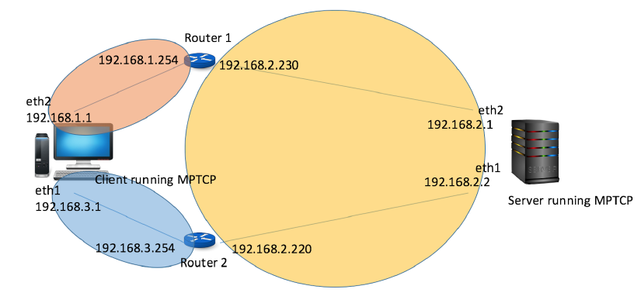
Implementation - Topology
Each router connect two different subnets, allowing client and server to communicate.
Two possible paths between client and server

Slide 4
Implementation - Technologies
Each network element a separate VM running over VirtualBox.
Client and Server run Ubuntu 14.04 with MPTCP kernel.
Routers run Ubuntu Server 14.04 with Quagga routing suite.
Network bandwidth limited using wondershaper
Bandwidth measurement using iperf3

Slide 5
Overview of experiments
Validate the key benefits of MPTCP, and compare against TCP
Efficiency
Reliability
Bandwidth Aggregation
Fairness to TCP

Slide 6
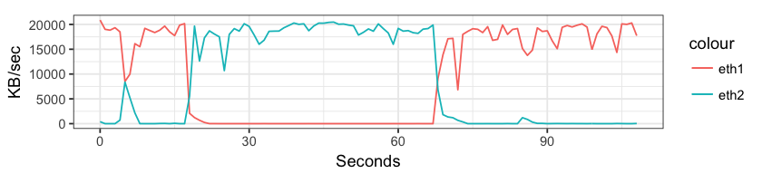
Results - MPTCP Efficiency
MPTCP should send traffic on the most efficient (least congested, least RTT) path
Experiment:
1. Start with two paths with equal RTT, congestion
2. Introduce congestion on Path 1 (20 seconds)
3. Reduce congestion on Path 1 (40 seconds)
4. Increase congestion on Path 2 (75 seconds)
Observation:
1. MPTCP quickly adapts to congestion
2. Sends ALL its traffic on its least-congested paths

Slide 7
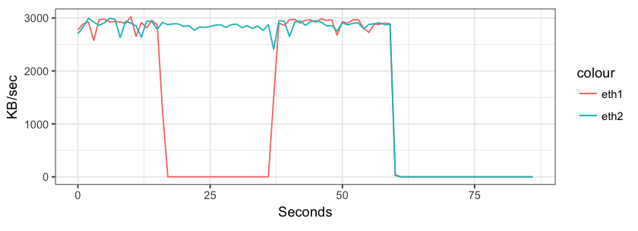
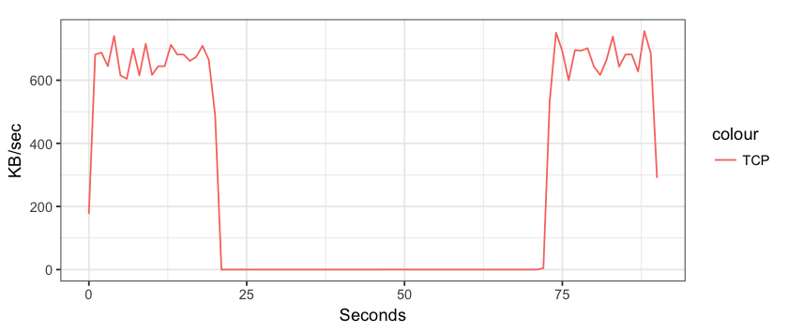
Results - MPTCP Reliability
MPTCP should provide reliable communication across the available paths.
Experiment:
1. Limit the capacity of each available path to ~2 MBPS.
2. Send data using MPTCP.
3. Disconnect one of the paths.
Repeat the same experiment for TCP.
Observation:
1. MPTCP maintains continuous data transfer through all available paths, even if some of the paths are unavailable for some duration.
2. TCP does not switch to the other available path when one a path in use is broken.

Slide 8
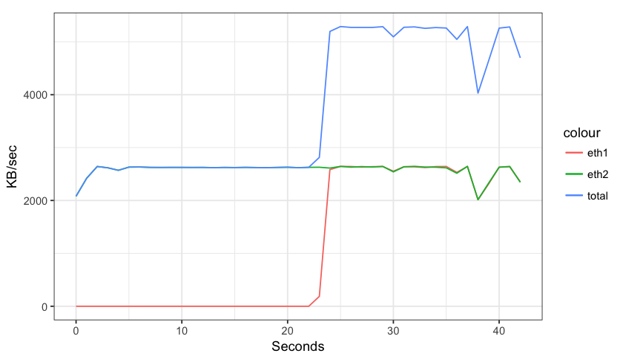
Results - MPTCP Bandwidth Aggregation
MPTCP provides bandwidth aggregation capabilities by making use of all available resources. (limited capacity)
Experiment:
1. Start data transfer on one of the paths.
2. Make a new path available to MPTCP in between the transfer.
Observation:
MPTCP starts sending data through the new path as it becomes available, thus increasing total available bandwidth.

Slide 9
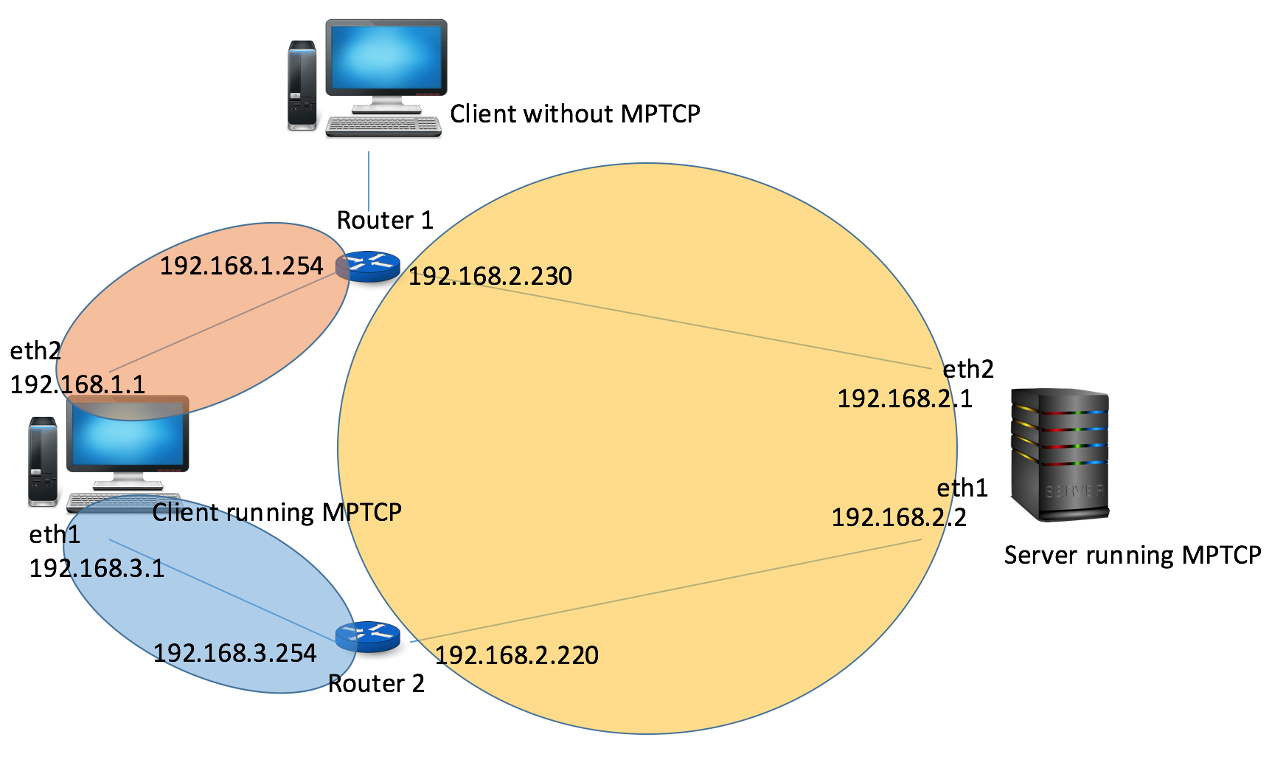
Results - Fairness to TCP
Goal: MPTCP should use as much resources as available, while being fair to TCP.
Experiment: Introduce a new client (client 2) without MPTCP.
1. Start data transfer from client2 to server.
2. Start MPTCP transfer from client1 to server.

Slide 10
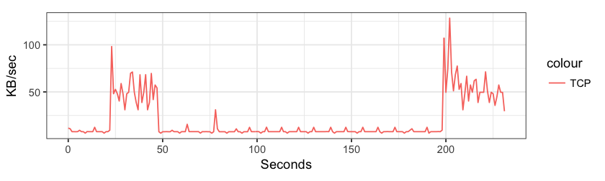
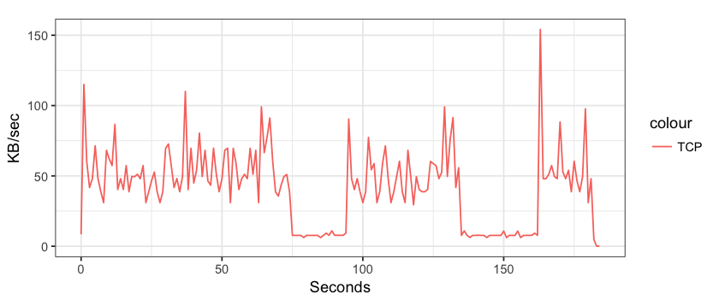
Results - Fairness to TCP
Observation:
1. Default TCP congestion control mechanism used in MPTCP.
2. When sharing bottleneck links, MPTCP gets higher bandwidth than competing TCP flows.
BALIA (Balanced Linked Adaptation Congestion Control) turns out to be more fair to TCP.
TCP still fails to get equal bandwidth share as MPTCP, and oscillates between 0% and 50% share.
Default TCP Congestion Control on MPTCP client
BALIA Congestion Control on MPTCP client

Slide 11
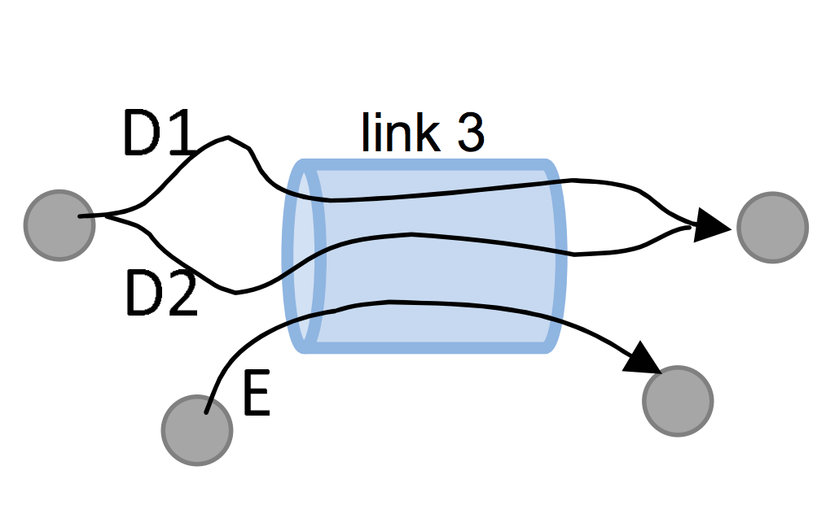
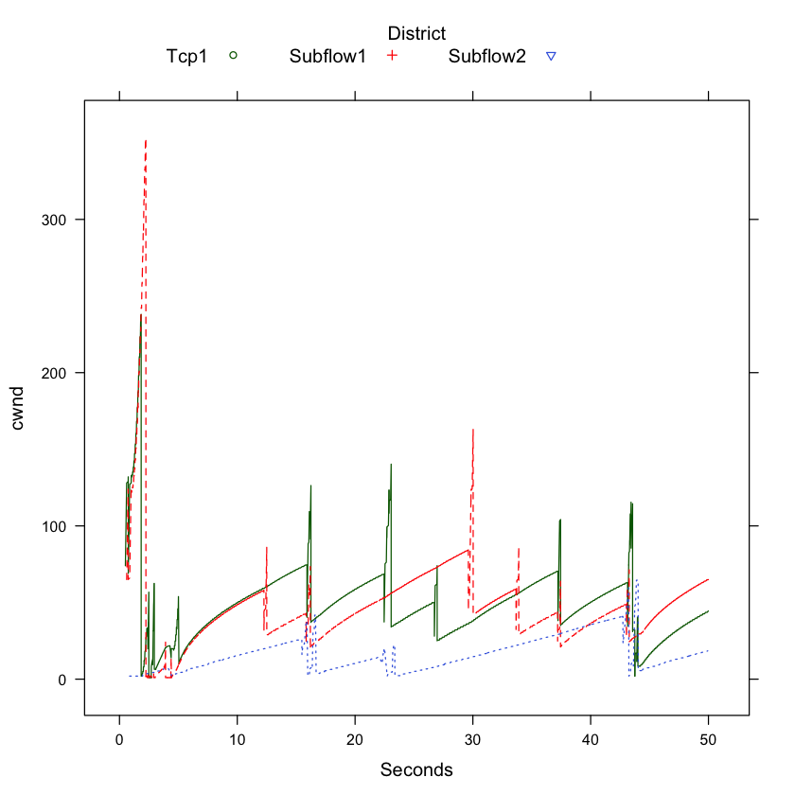
HTSIM results
Use HTSIM to verify the results obtained using our implementation.
Implemented a “bottleneck” topology with 2 multipath flows and 1 competing TCP flow.
Observation:
1. Contrary to our experiments, TCP congestion window size in HTSIM is larger than MPTCP.
2. Bandwidth output seems to be random values, not correlated to the cwnd. Needs further investigation.

Slide 12
Thank you!
Acknowledgements:
Dr. Alex Snoeren
Dr. Costin Raiciu
CSE 222a peers

